Slide 1

Power Point Presentation On
Covid-19 Prevention And Detection Management System
Presented By -
1 Shuvradip Chakraborty
2 Mainak Podder
3 Susmita Sarkar
4 Antara kangsabanik
5 Shibendu Gosh
6 Abhijit Mondal

Slide 2
About the Project
The project aims to develop content in the COVID-19 Category and also the respiratory and mental health section Of physiopedia as a response to the COVID -19 pandemic. We Initiated this site with practical , credible information on all Aspect of management of individuals with a diagonosis of COVID-19.
Here we describe about the cause and effect of COVID-19
Here we describe how people are contact with our doctors And Health Hospitals In Murshidabad and Nadia
Here we also Want to aware people and also we provide critical information for the people who needed the most
The details of doctors and hospitals, we also describe the Symptoms so that they can take prevention method.

Slide 3
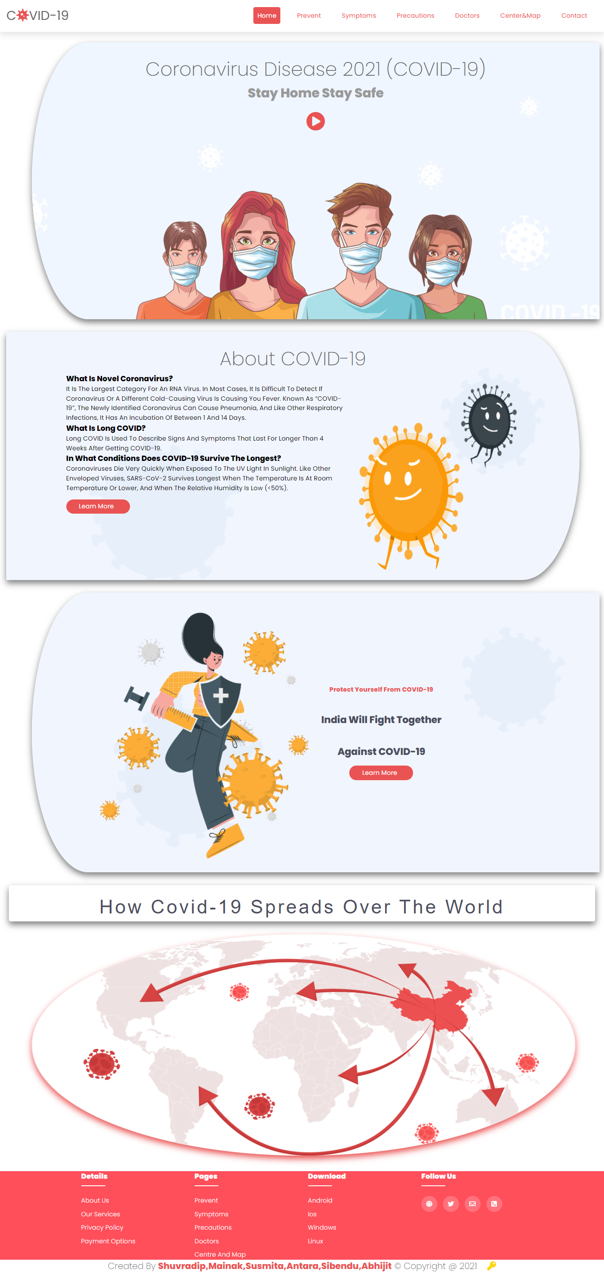
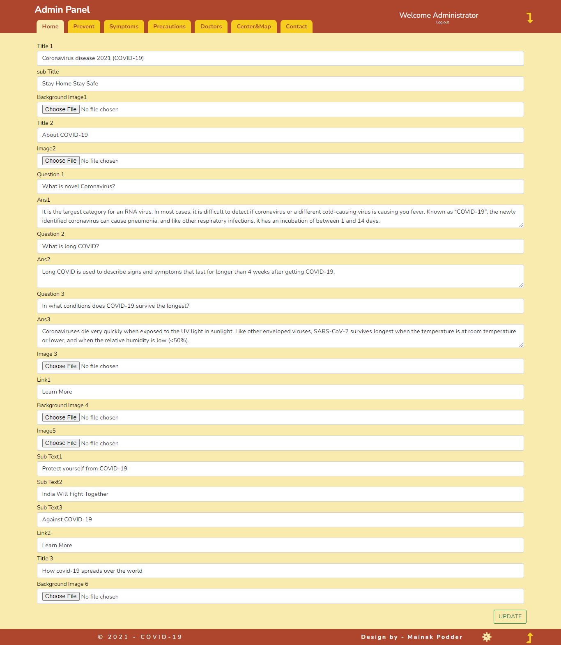
Project Screenshot (Home)

Slide 4
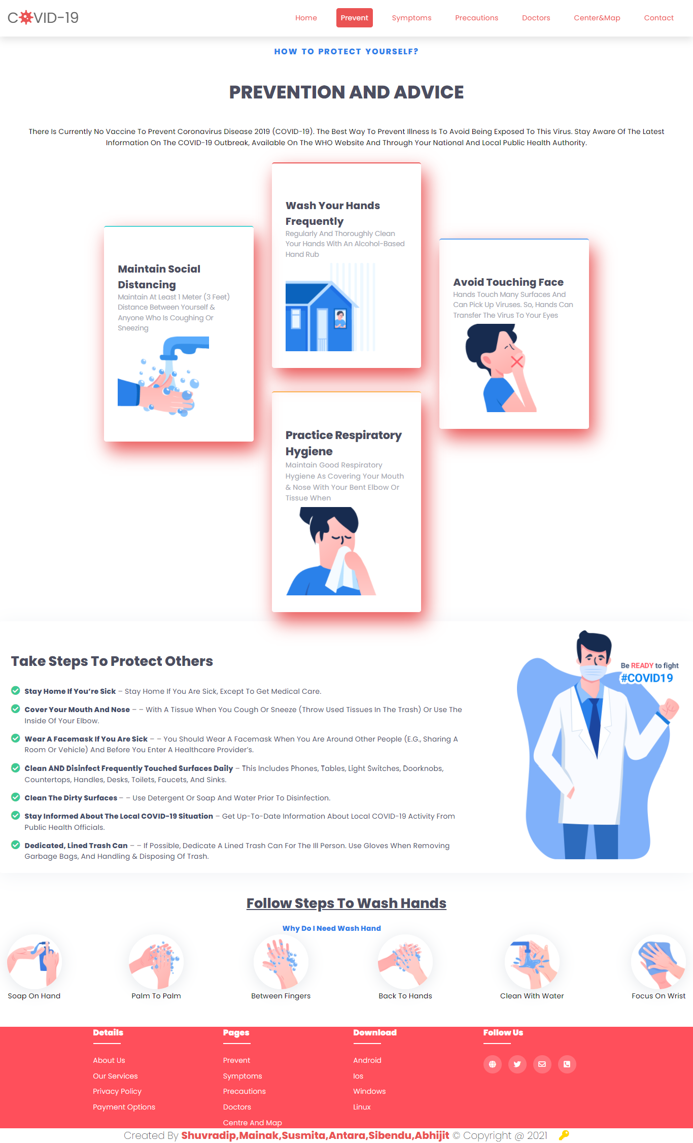
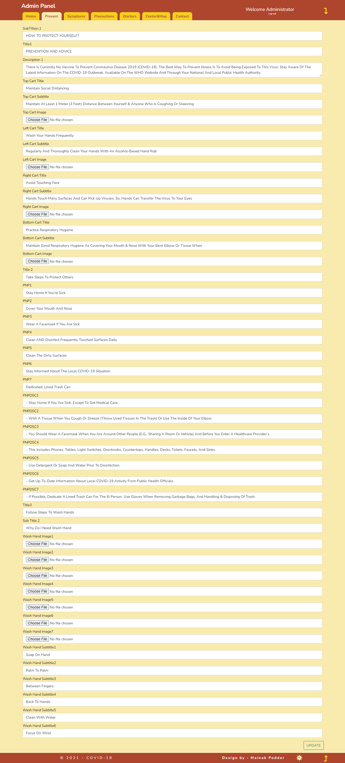
Project Screenshot(Prevent)

Slide 5
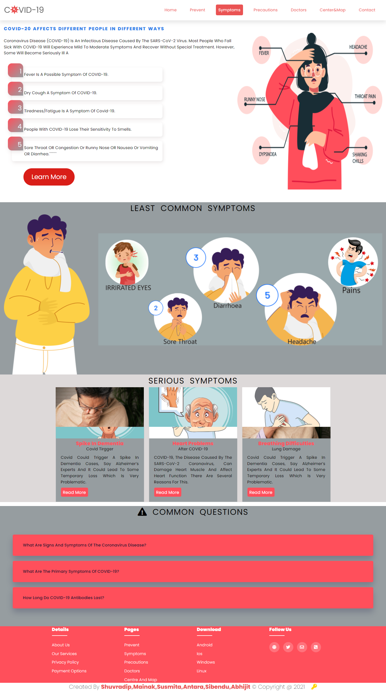
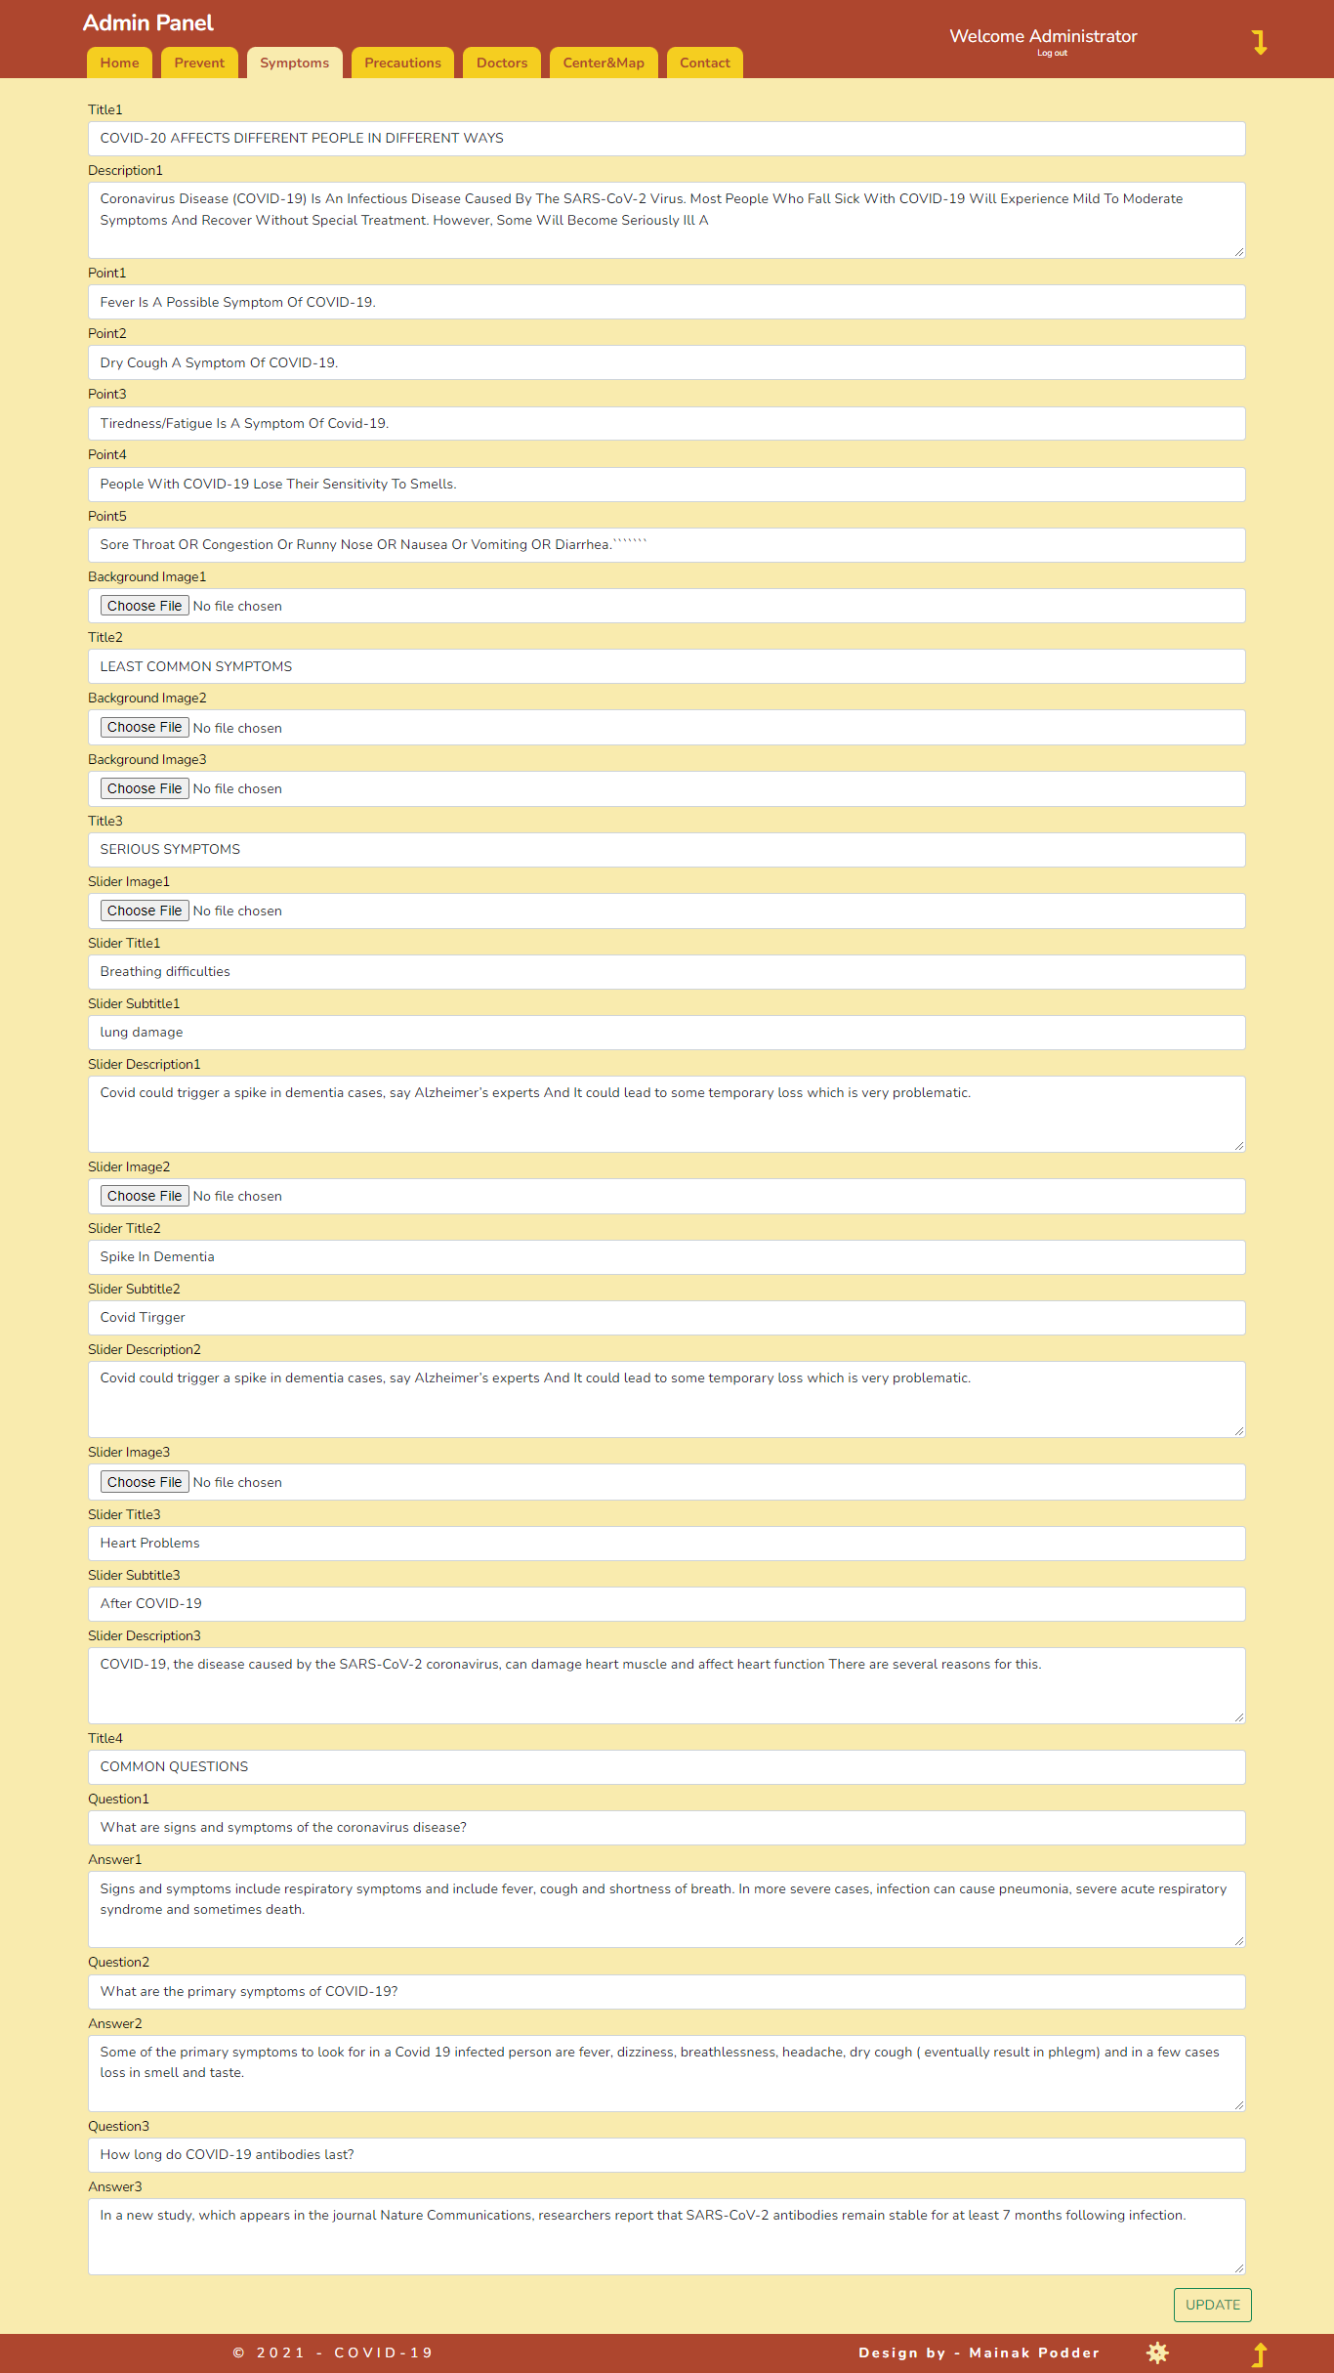
Project Screenshot

Slide 6
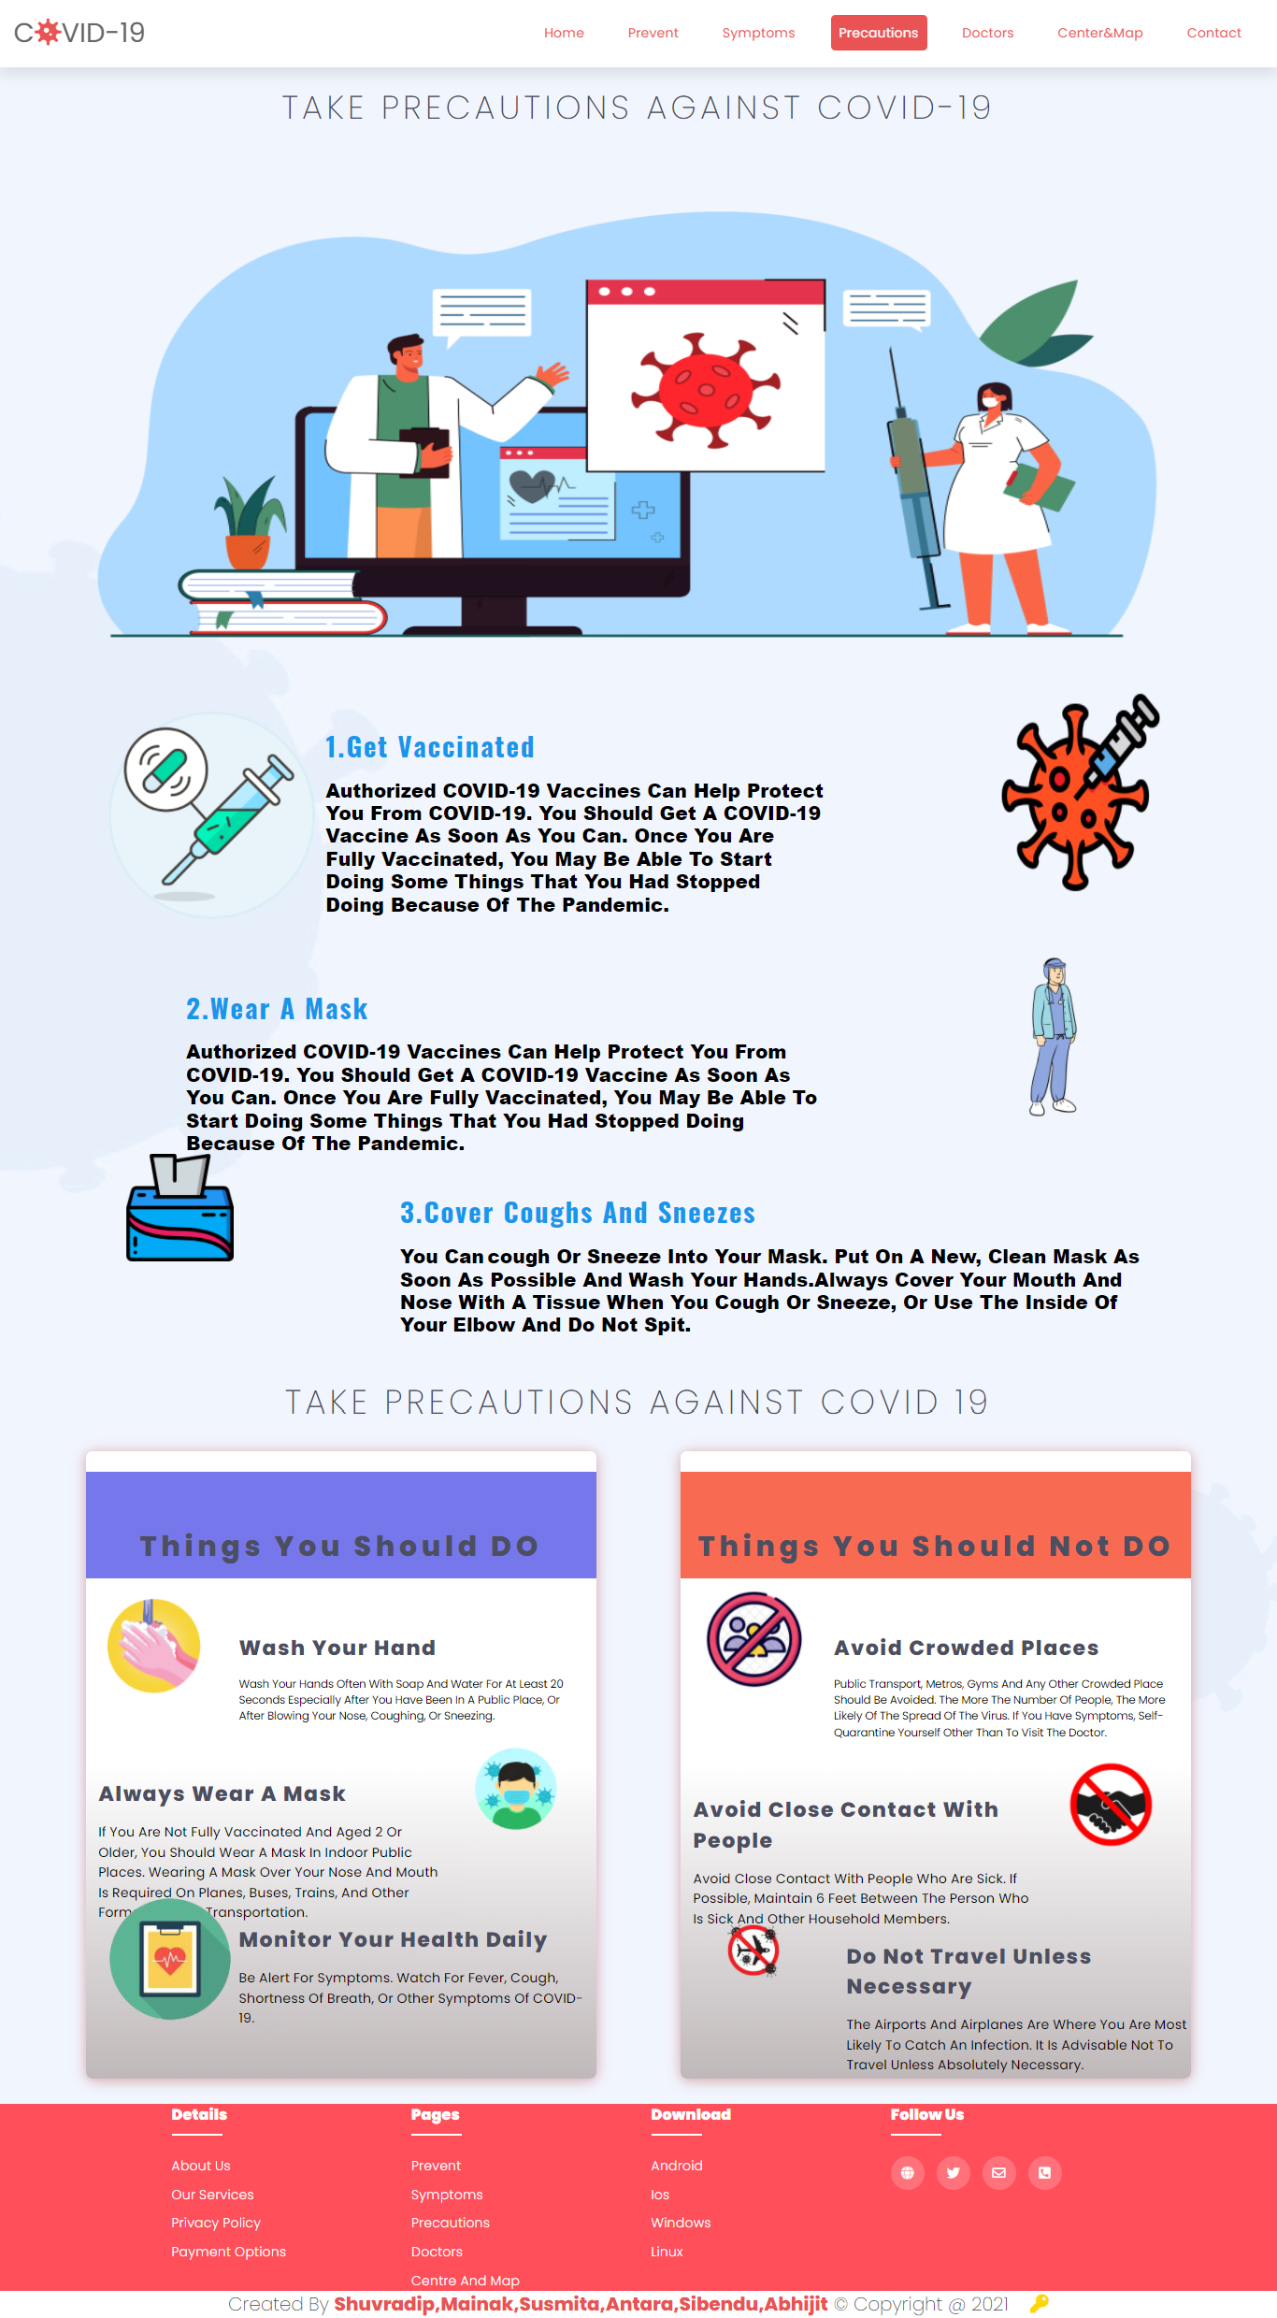
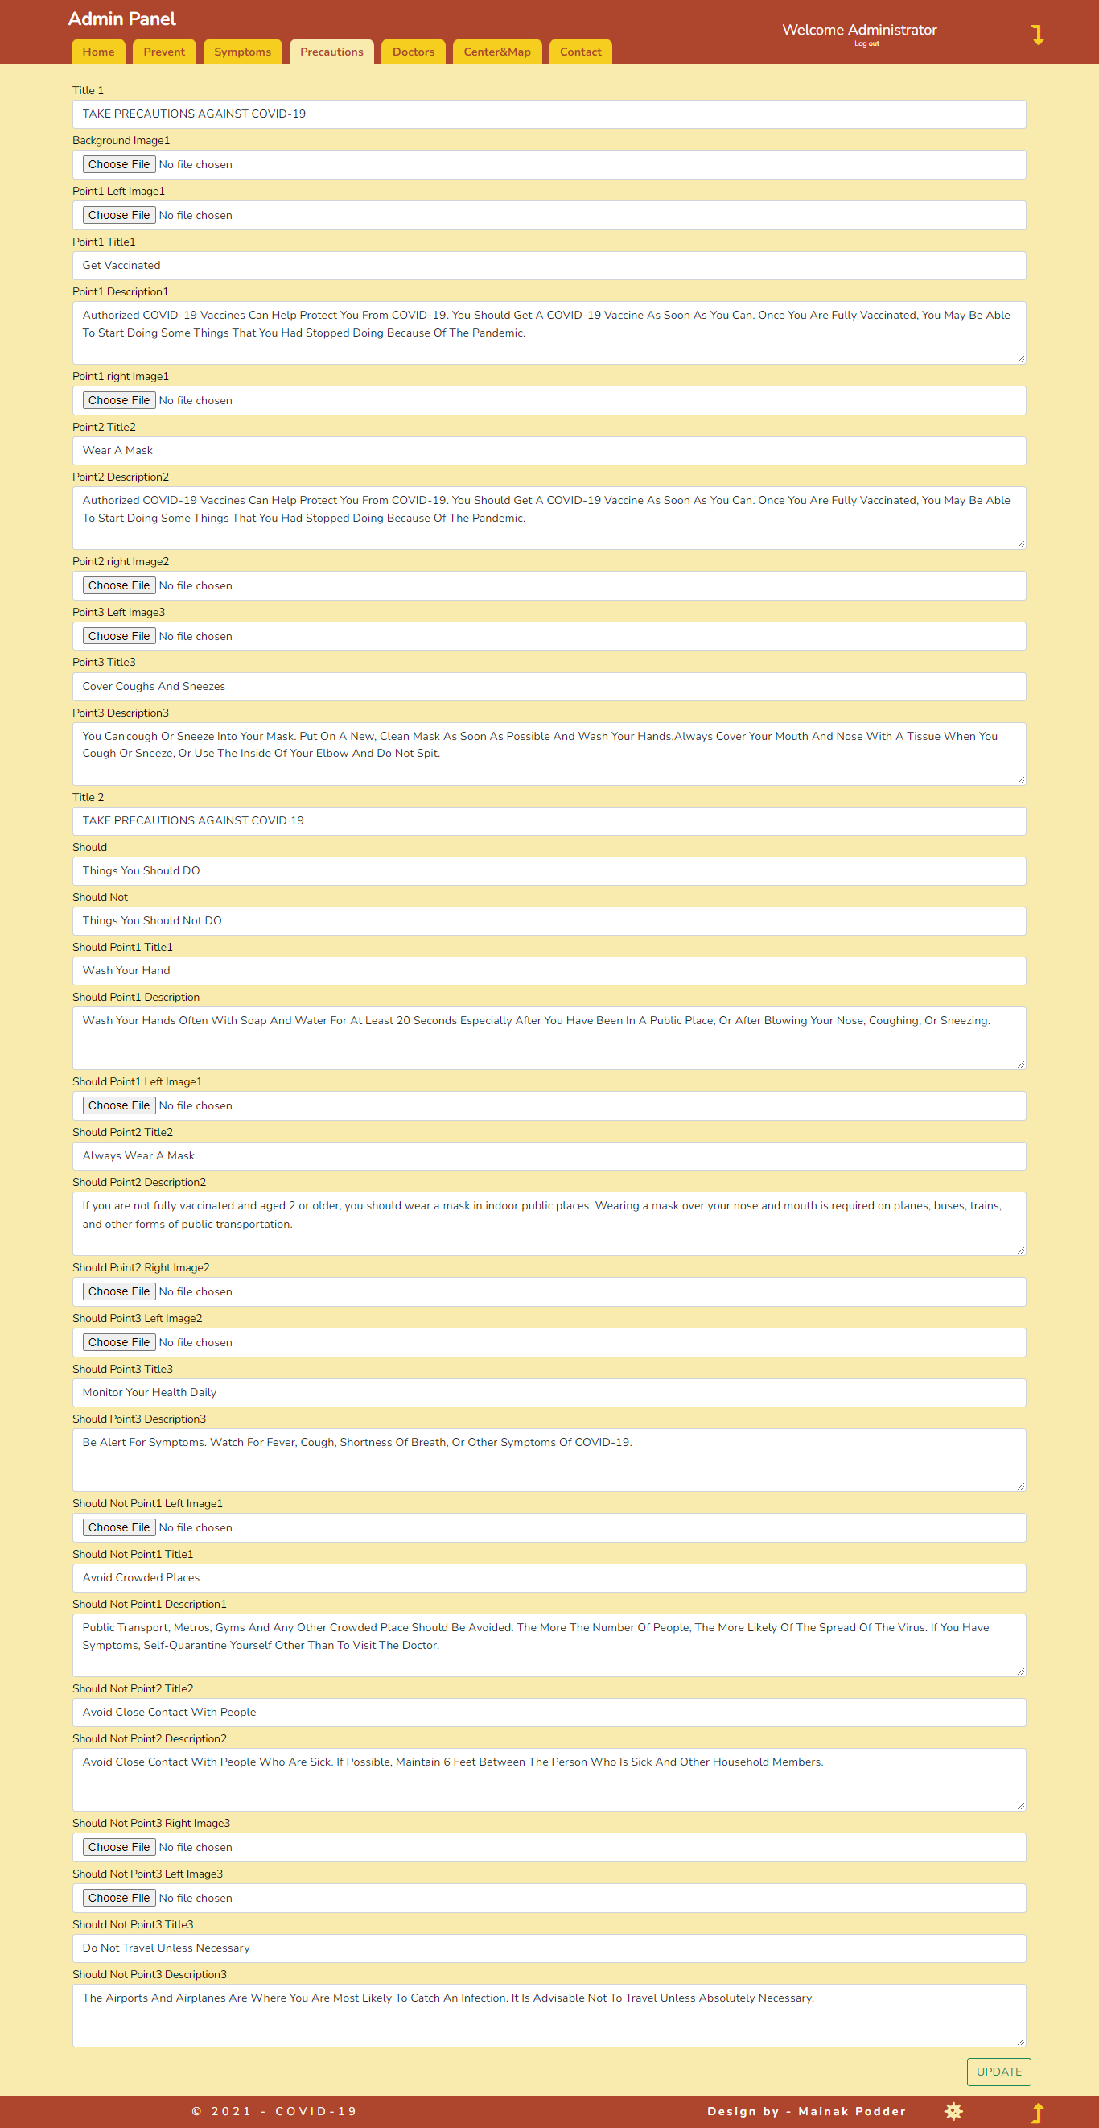
Project Screenshot

Slide 7

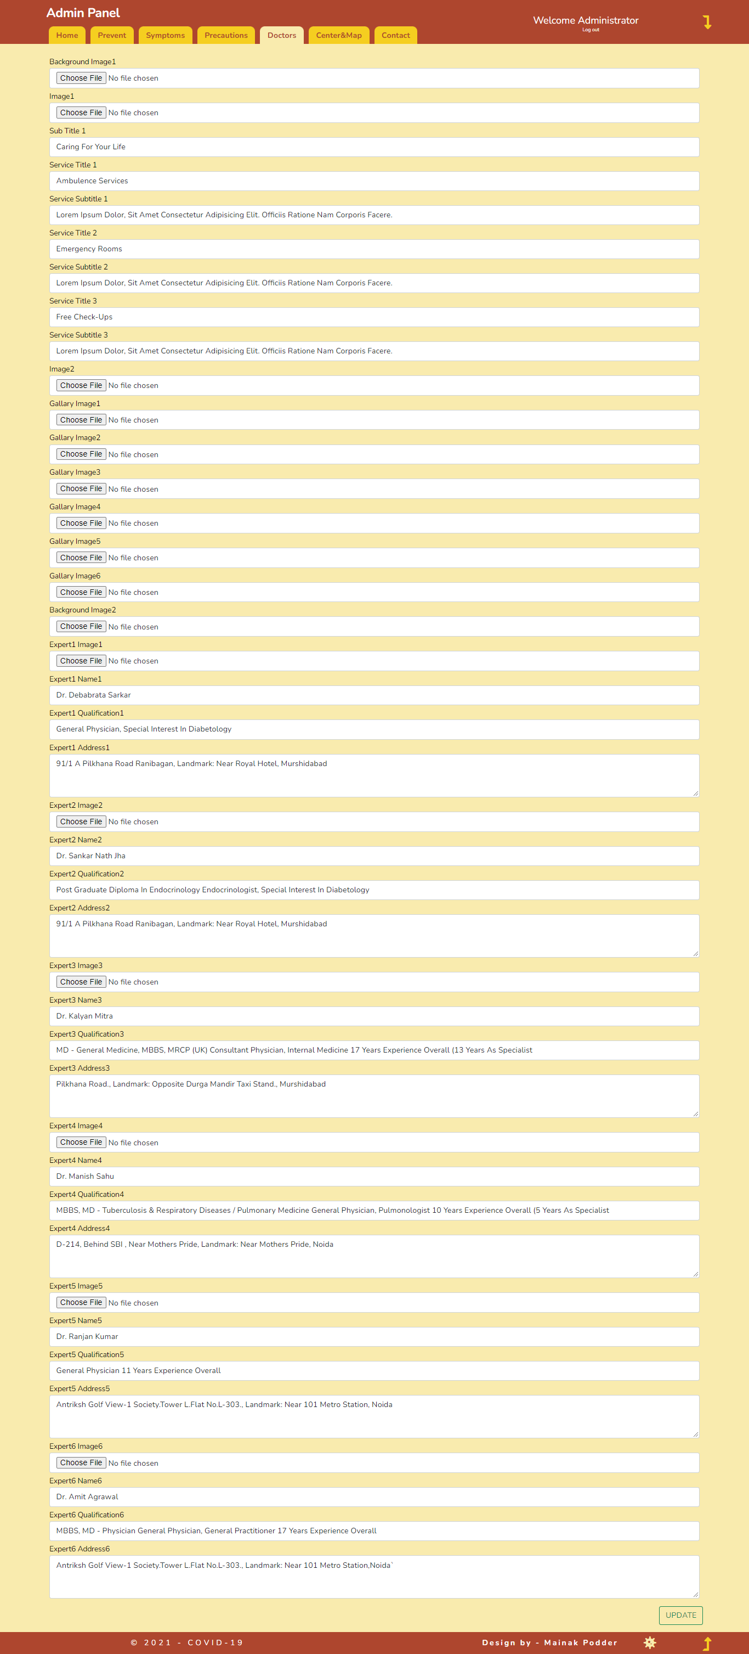
Project Screenshot

Slide 8
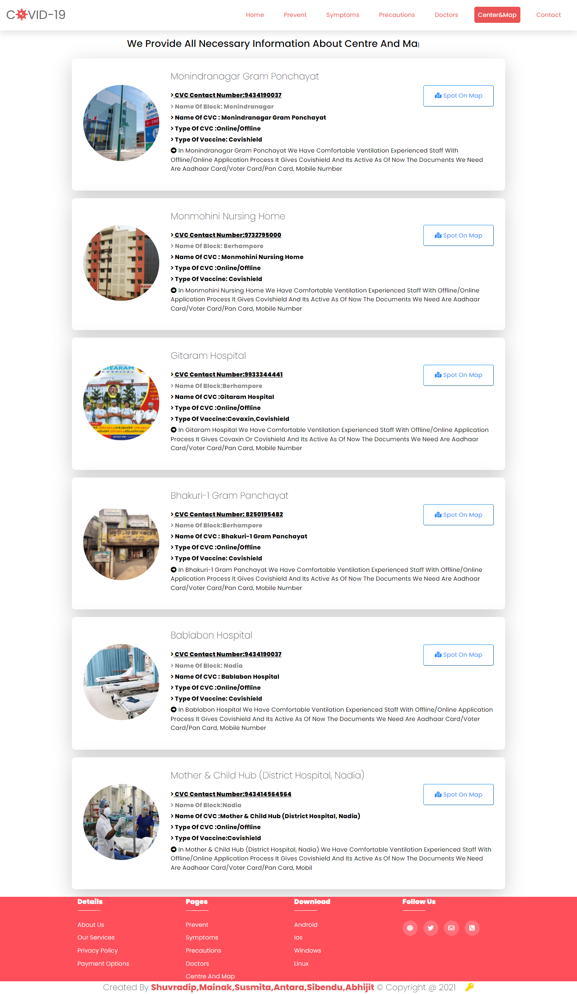
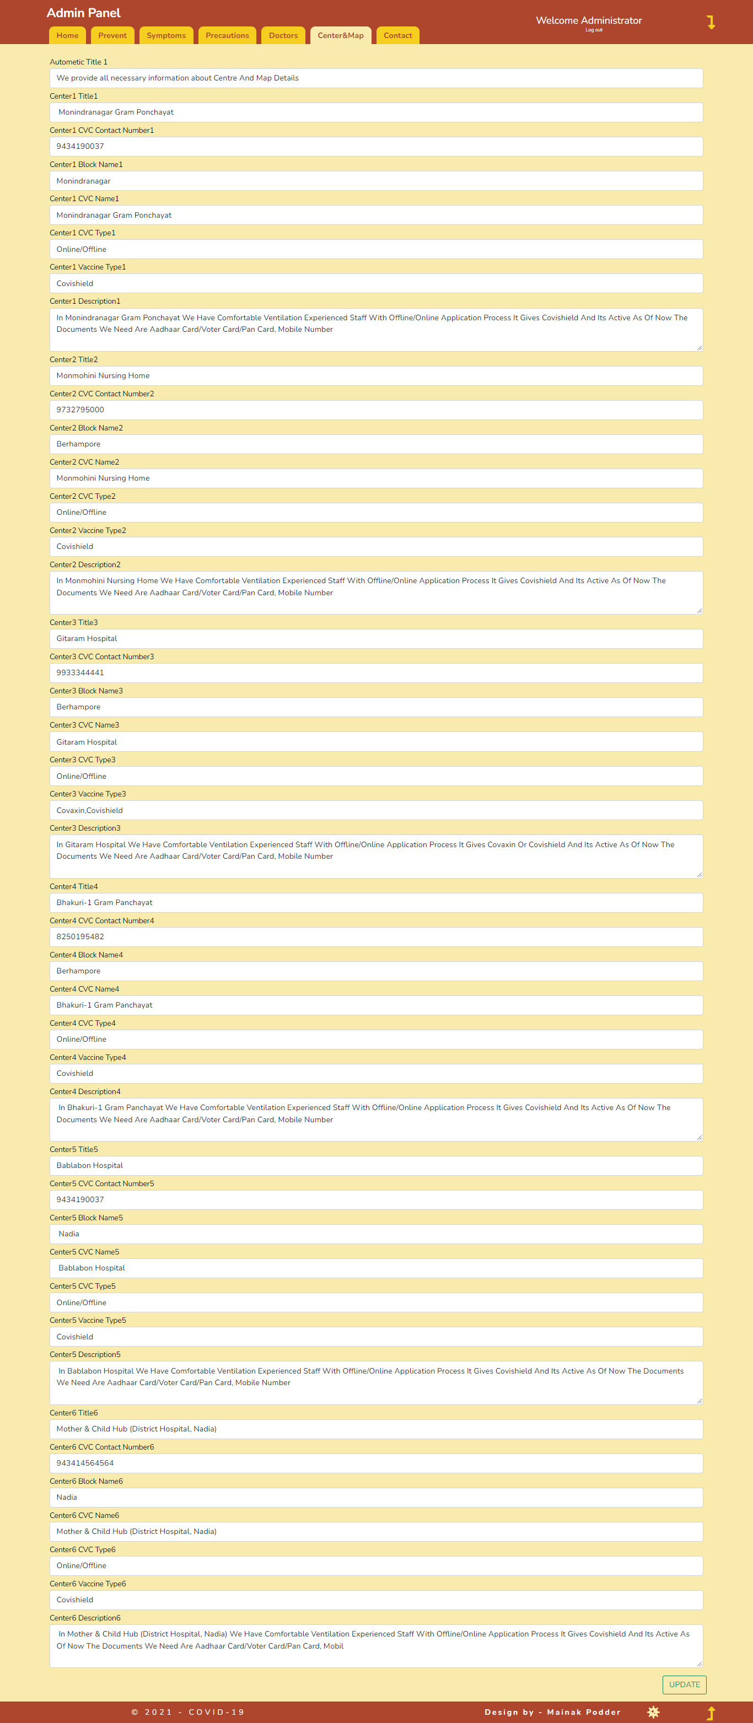
Project Screenshot

Slide 9
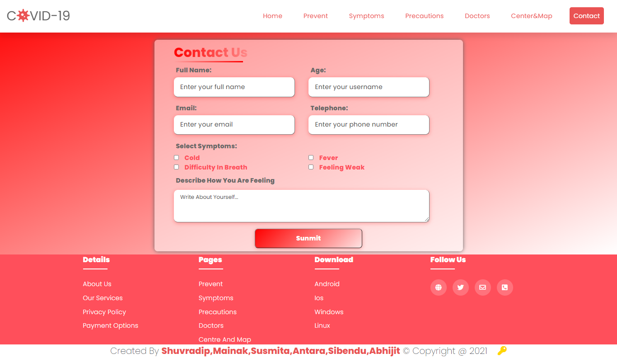
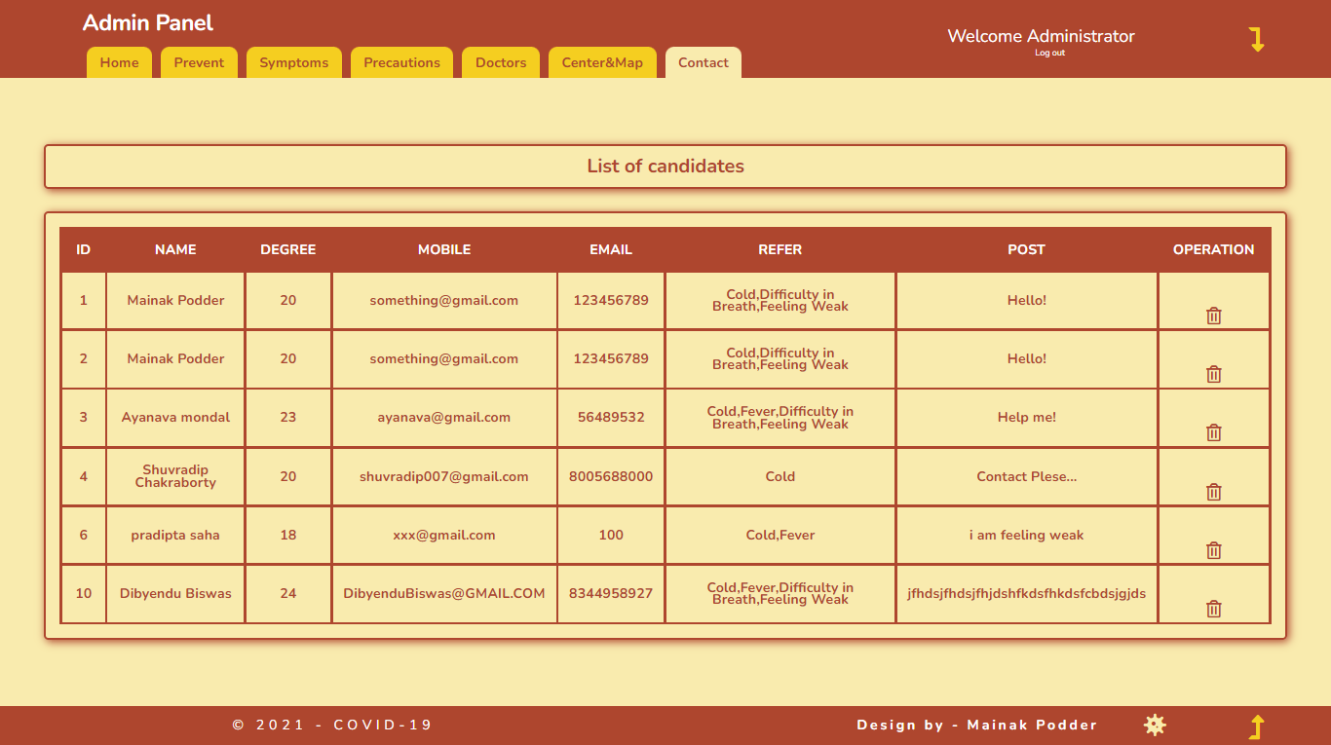
Project Screenshot

Slide 10
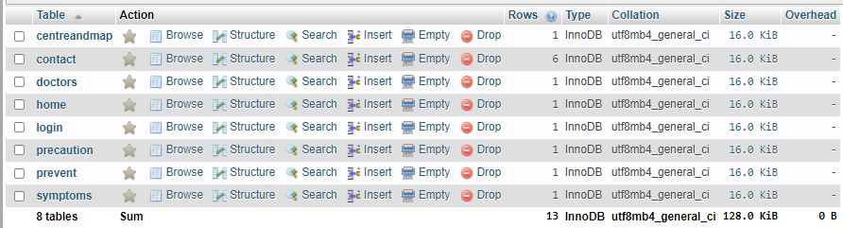
Table Screenshot

Slide 11
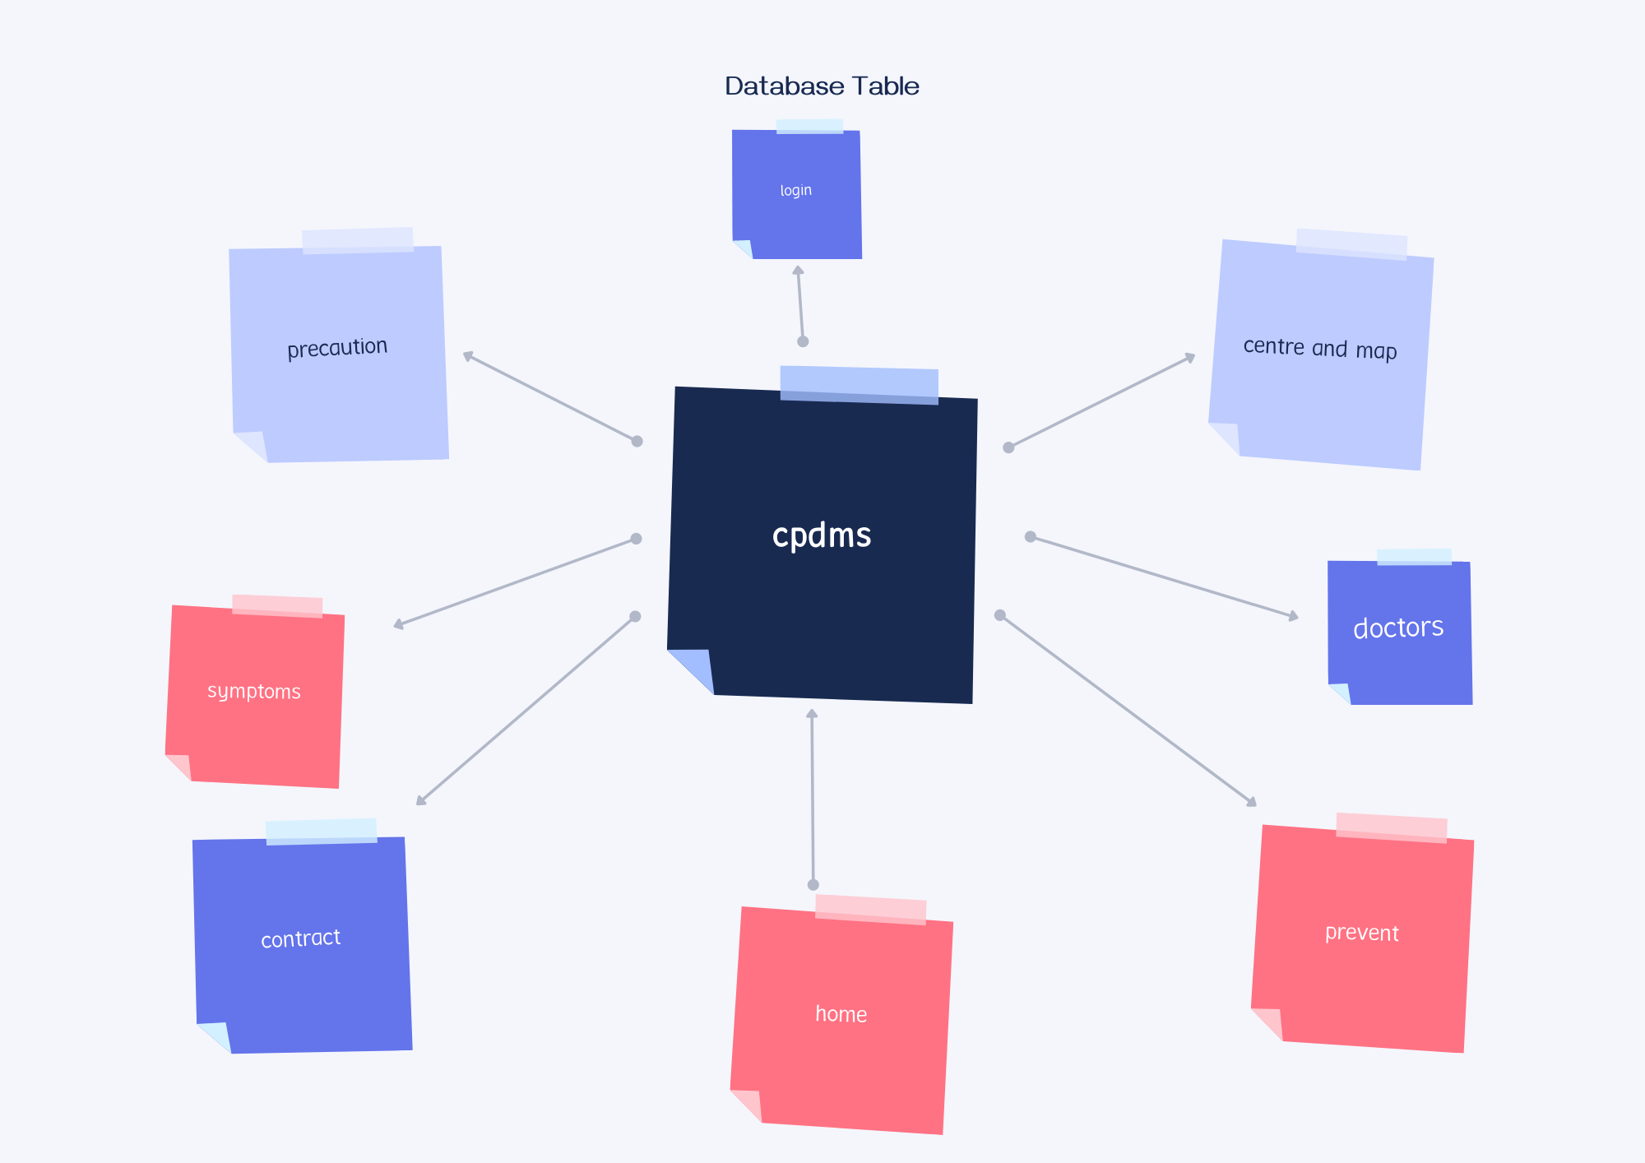
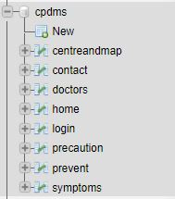
Database Table

Slide 12
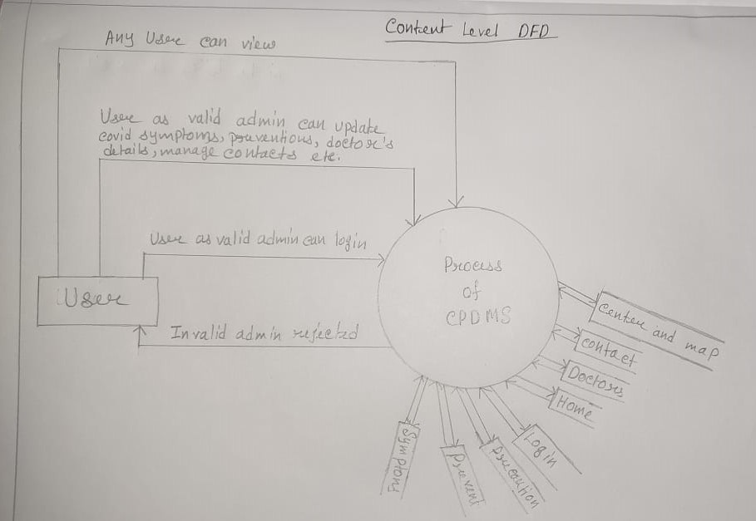
DFD (Data Flow Diagram) 1. Context level DFD

Slide 13
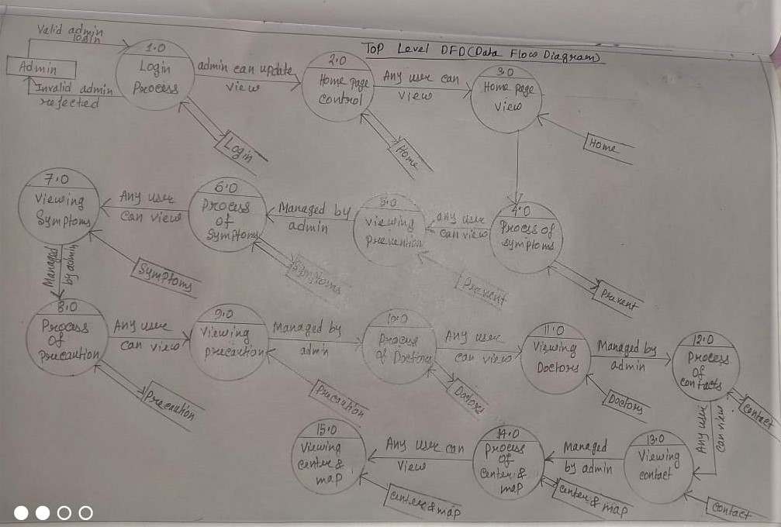
DFD (Data Flow Diagram) 2. Top level DFD

Slide 14
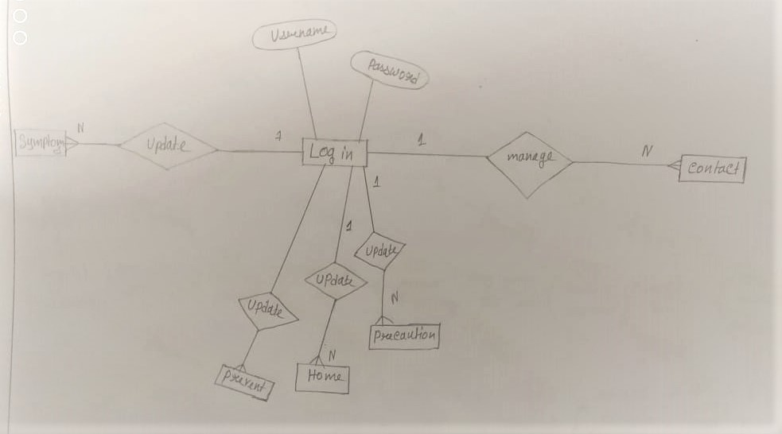
ERD (Entity Relationship Diagram)

Slide 15
BIBLIOGRAPHY
JAVA SERVLETS
- TATA McGraw HILL
SOFTWARE ENGINEERING
- McGraw-Hill Publications
[J2EE-Overview] - http://java.sun.com/j2ee/overview.html
[JS-NET] -
http://developer.netscape.com/docs/manuals/communicator/jsref/contents.htm
[J2EE-Home] - http://java.sun.com/j2ee/
[J2EE-Components] - http://java.sun.com/j2ee/blueprints/platform_technologies/component/index.html
[SUN-Developer] - http://developer.java.sun.com/developer/
15

Slide 16
Thank You

